Slide 1
Chiba Campaign 2020 Daily Report (11/30~) : Tropospheric NO₂, Planetary Boundary Layer Height 2020/12/02
Irie Laboratory Saito Hikaru(齊藤 輝)

Slide 2
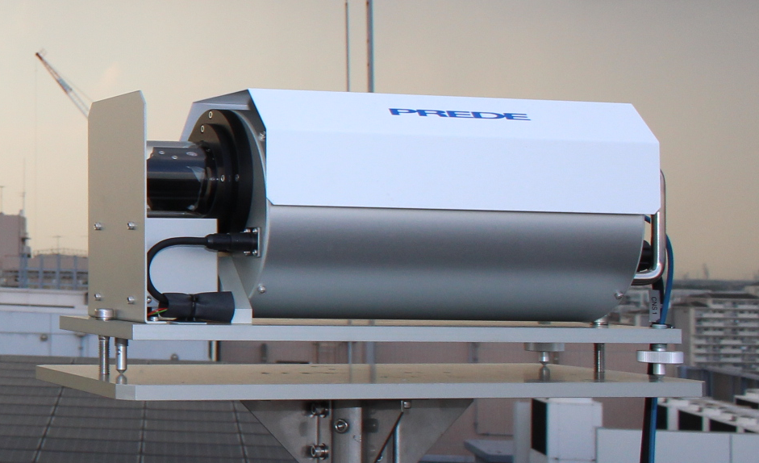
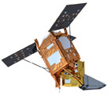
Tropospheric NO₂ column density data
4AZ-MAXDOAS (Ground-based)
Plot…
・All measurements
・Daily average
TROPOMI (TROPOspheric Monitoring Instrument) (Satellite-based)
Plot…
・Daily 0.2°×0.2° average
・Standard Deviation in pixels of 1-day data
1995
2002
2004
20km

Slide 3
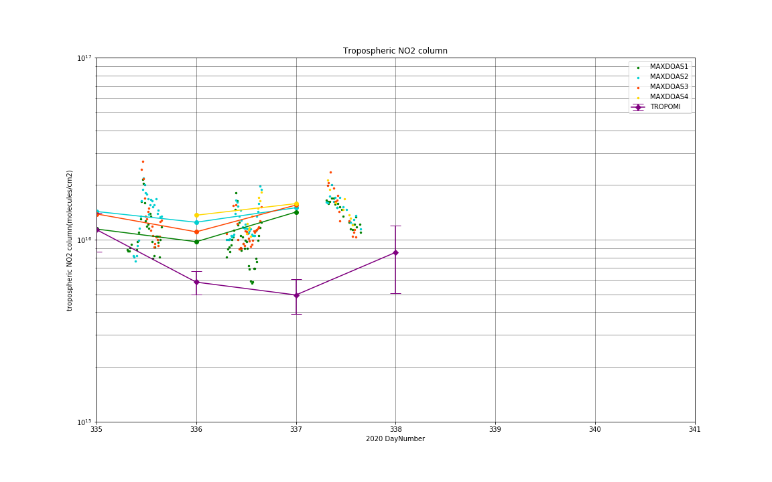
1995
2002
2004
20km

Slide 4
Mixing (Planetary Boundary) Layer Height (大気境界層の厚さ) ・Varies depending on daytime/seasons ・Possibly affect satellite observation
http://wwwoa.ees.hokudai.ac.jp/research/pbl.html

